Slide 1

Image Restoration with Diffusion Model
Capstone Project Phase A
24-2-R-5
Roi Darom
Hagar Tibi
Supervisors: Dr. Renata Avros & Prof. Zeev Volkovich

Slide 2
Purpose of the project
The methodology developed to repurpose camouflaged object detection using diffusion models is going to be applied and extended for restoring and enhancing the quality of damaged images (particularly medical).

Slide 3
What is Camouflage ?
Camouflage is the phenomenon where an object naturally blends into its environment, making it less noticeable to observers.
Camouflaged object detection is challenging due to the high visual similarity between the object and the background.
The problem is crucial in various fields like military, medical imaging, and wildlife monitoring.

Slide 4
Introduction to diffCOD Framework
Diffusion Models: Approach COD (Camouflaged Object Detection) as a denoising process
Training Process: The model learns to recognize objects within noised images using the reverse diffusion process
Key Component: Injection Attention Module (IAM) enhances the denoising capability

Slide 5
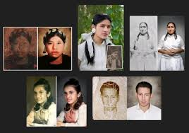
Image Restoration Overview
Process:
Reconstructing images degraded by noise, blurring, or timing
Challenges:
Deal with various types of distortions
Parts of the image may be missing and going to be restored

Slide 6
From COD to image restoration
Using diffusion models for image restoration.
Both tasks (COD, Restoration) focus on noise transforming or recognition of hidden and not observed data
The same principles that help detect hidden objects can be applied to restore and enhance damaged images.

Slide 7
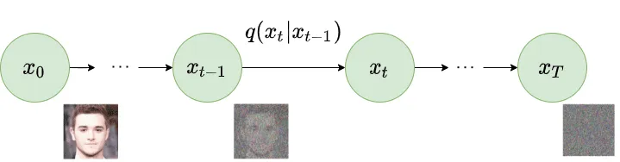
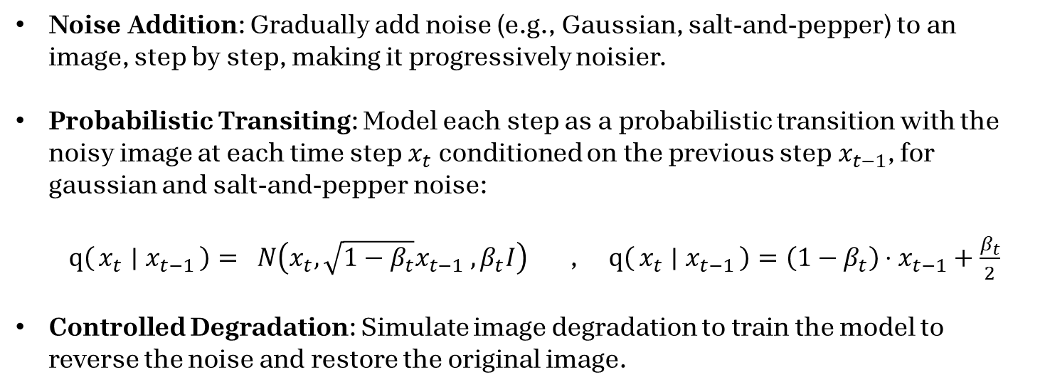
Forward DIFFUSION process
Noise Addition: Gradually add noise (e.g., Gaussian, salt-and-pepper) to an image, step by step, making it progressively noisier.
Probabilistic Transiting: Model each step as a probabilistic transition with the noisy image at each time step$x_{t}$​ conditioned on the previous step$x_{t−1}$​, for gaussian and salt-and-pepper noise: $q\left(x_{t} ∣ x_{t−1}\right)= N\left(x_{t}, \sqrt{1−β_{t}}x_{t−1} ,β_{t}I\right)$ , $q\left(x_{t} ∣ x_{t−1}\right)=\left(1−β_{t}\right)⋅x_{t−1}+\frac{β_{t}}{2}$
Controlled Degradation: Simulate image degradation to train the model to reverse the noise and restore the original image.

Slide 8
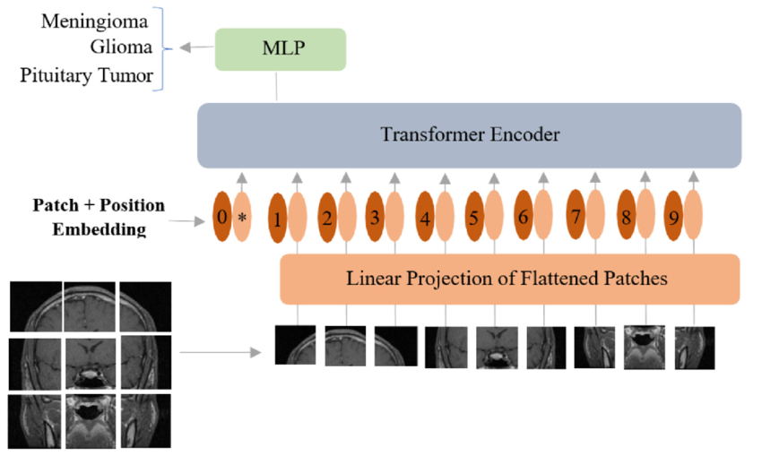
Vision Transformer (ViT)
The ViT is Used for image classification, detection, and segmentation, capturing local and global details. It’s also a backbone for multi-scale feature extraction in tasks like camouflaged object detection and image restoration.
ViT Process:
Patch Processing: Divides the image into patches, embeds each into a fixed-size vector.
Positional Encoding: Adds spatial information to patch embeddings.
Self-Attention Mechanism: Uses transformer layers to capture long-range dependencies.
Multi-Scale Feature Extraction: Processes patches at various resolutions to capture detailed features.

Slide 9
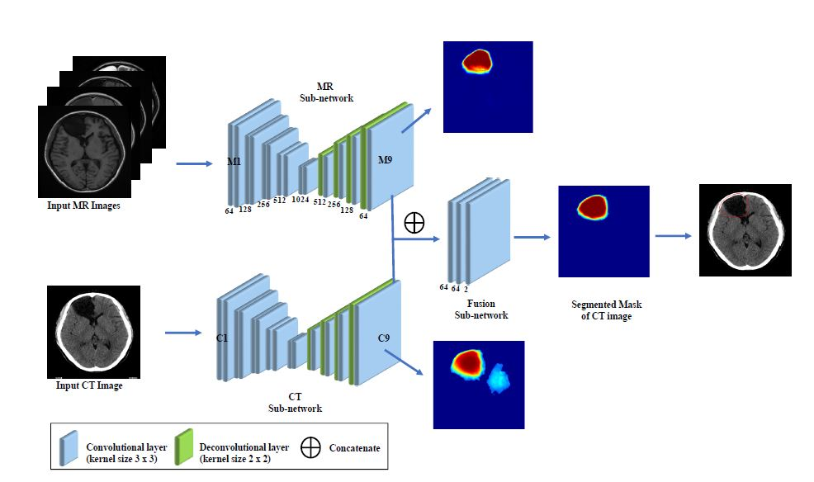
Feature Fusion (FF)
Multi-Scale Integration: The FF module merges features from different scales, capturing fine details and broader patterns, enriching the image representation.
Dynamic Weight Adjustment: During training, the module learns to prioritize key features with dynamic weights, often using attention mechanisms to improve focus.
Enhanced Image Processing: By combining multi-scale features, the FF module refines and improves image outputs, especially in tasks like restoration, segmentation and detection.

Slide 10
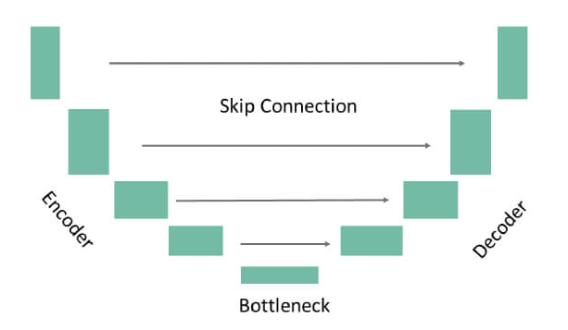
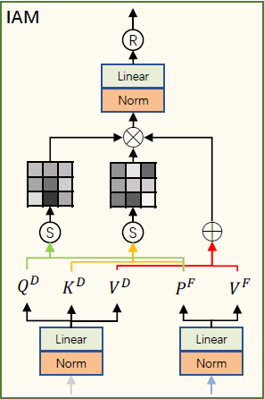
Denoising U-Net & IAM
Encoder: Downsamples the input, extracting multi-scale features while preserving essential information, reducing spatial dimensions progressively.
IAM in the Bottleneck: Integrated into U-Net's bottleneck, enhancing feature refinement by focusing on critical textures, guiding effective denoising.
Decoder: Upsamples encoded features to reconstruct the image, using transposed convolutions to restore resolution with a focus on detail.
Skip Connections: Link encoder and decoder layers, retaining high-resolution features to preserve fine details in the denoised output.

Slide 11



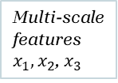
Model’s Process
Dynamic weight adjustment
Input Image
ViT – image processing
Multi-scale features$x_{1},x_{2}$, $x_{3}$
FF – feature extraction
$$x_{0}$$
$$x_{0}$$
Feature Map F
Noise addition
Denoising U-Net Encoder – Extract deepest features
IAM – guide diffusion process
Denoising U-Net Decoder – Produce Refined version
Restored Image
$$y_{t}$$
Feature Map D
Feature Map O
Salt-and-Pepper Noise
$$y_{t−1}$$

Slide 12
Model’s Process
Dynamic weight adjustment
Input Image
ViT – image processing
Multi-scale features$x_{1},x_{2}$, $x_{3}$
FF – feature extraction
$$x_{0}$$
$$x_{0}$$
Feature Map F
Noise addition
Denoising U-Net Encoder – Extract deepest features
IAM – guide diffusion process
Denoising U-Net Decoder – Produce Refined version
Restored Image
$$y_{t}$$
Feature Map D
Feature Map O
Salt-and-Pepper Noise
$$y_{t−1}$$

Slide 13
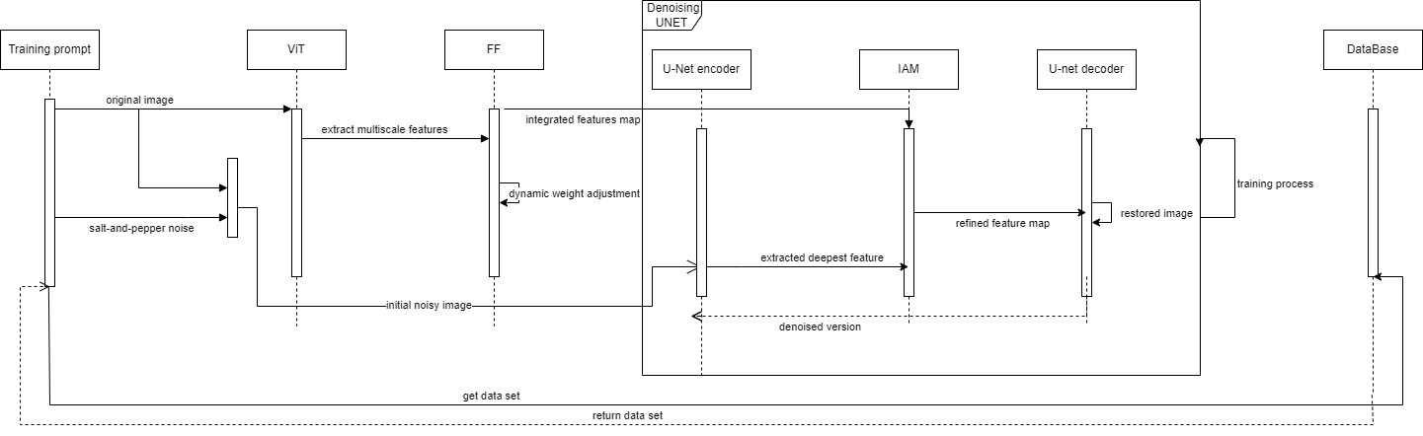
Sequence

Slide 14
Testing plan
Module | Test Description | Expected result
Input Preprocessing | Test the ability to handle batch processing of images. | The system processes batches of 100 images within a short timeframe, maintaining consistent quality across all outputs.
Feature Extraction | Verify extraction of relevant features from noisy images across multiple scales (resolution) | Extracted feature maps consistently capture essential details, with feature detection accuracy exceeding 90% across all scales.
Denoising and Reverse Process | Validate ability to remove noise and restore images to near-original state. | Denoised images achieve PSNR values of at least 30 dB, indicating effective noise removal.
Injection Attention Module (IAM) | Ensure integration of semantic features to refine and enhance restoration. | Improved image quality is evidenced by a 10% increase in SSIM, confirming the IAM's enhancement capabilities.
Output Module | Confirm final output images meet quality standards in sharpness and clarity. | Restored images achieve SSIM scores above 0.85 and PSNR values above 30 dB, indicating high-quality restoration.
 | Evaluate performance with edge cases, such as very high or low-resolution images. | High-resolution images maintain SSIM above 0.8, while low-resolution images achieve at least a 0.75 SSIM.

Slide 15
Thank you for listening

